Slide 1


Information Marketing Group, Inc.
Grading Tutorial for iPass Administrators

Slide 2
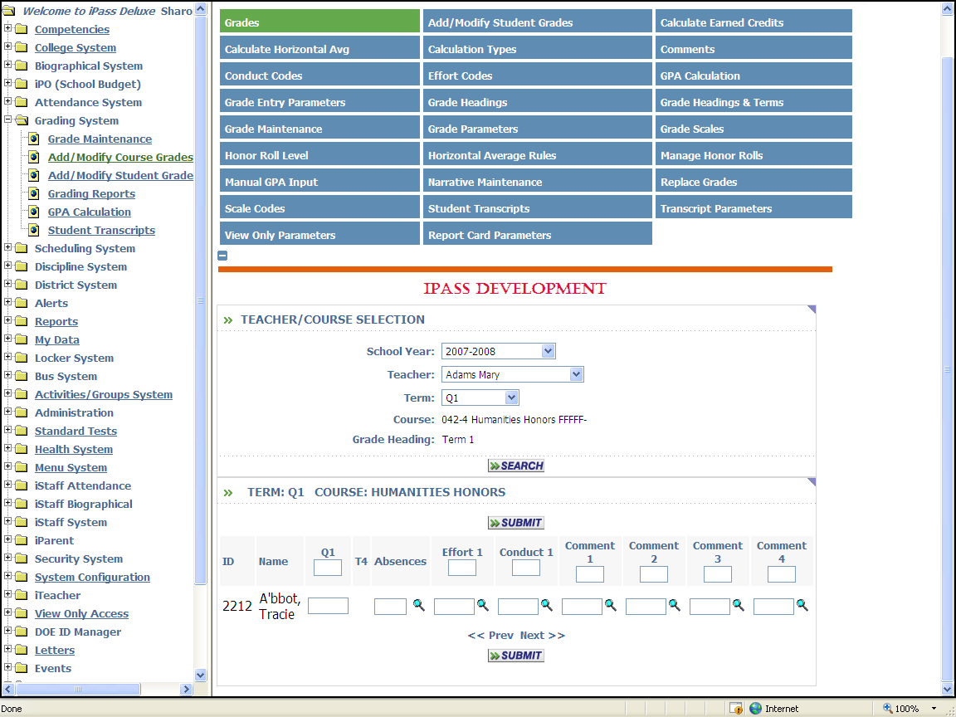
Grading with iPass
Click on <iTeacher> <Add/Modify Course Grades>
This screen allows teachers to enter grades for students scheduled into their classes only. Simply click the appropriate term, and select the course of choice.

Slide 3
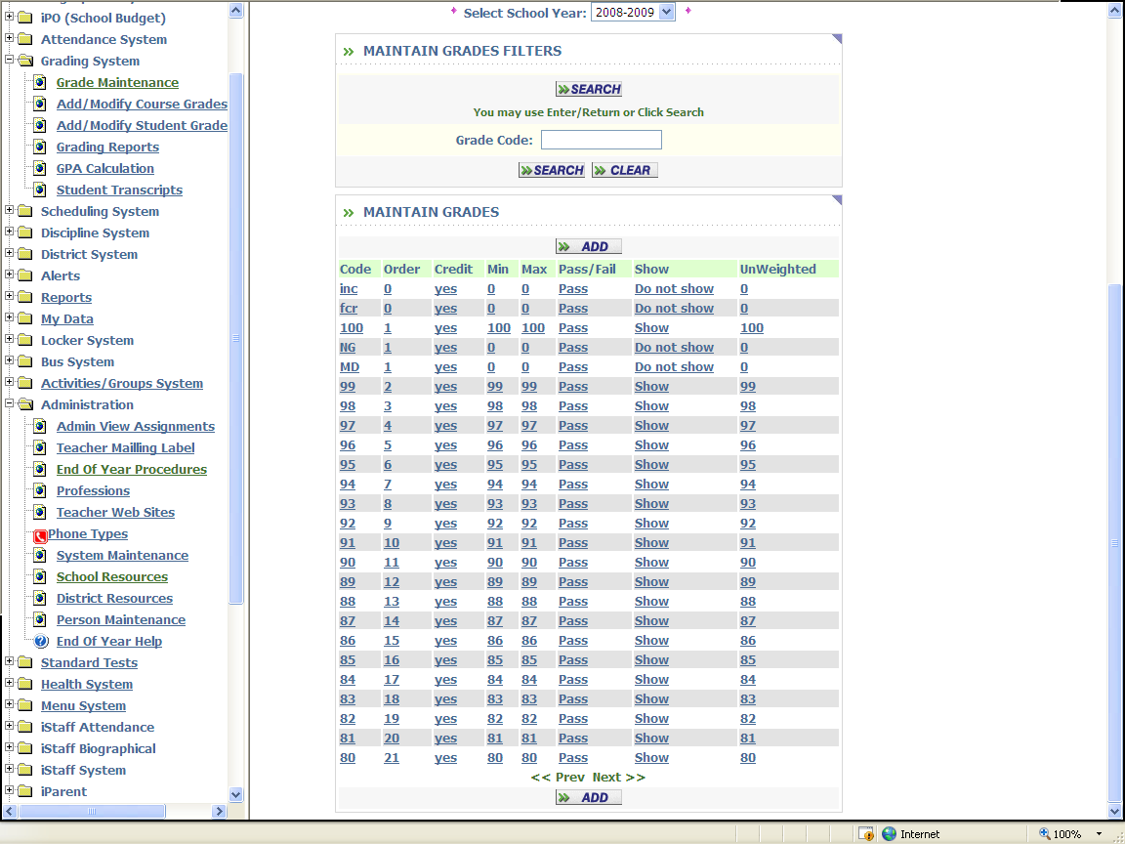
Define Grades
Go To: <Grading System> <Maintenance> <Maintain Grades>
This table is academic year specific and can be copied from a previous year using <Administration> <End of Year Procedures> <Grades Rollover>.
This table can also be copied by teachers into their Rankbooks to insure consistency.
Review the grades listed. Click on any piece of data for the grade code that you wish to modify or Click to define a new grade code.

Slide 4
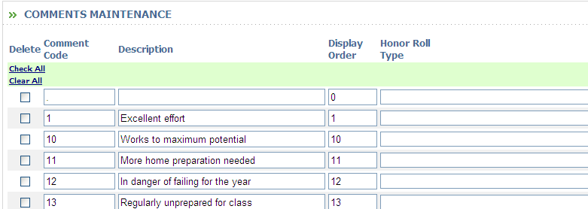
Define Comments
Go To: <Grading System> <Maintenance> <Comments>
This table is not academic year specific. Care should be taken when changing comments. It will change the comments assigned in the previous years.
Helpful Hint!
While alpha codes are acceptable, it is suggested that numeric codes be used to provide for quicker data entry from the number pad. Numbered codes do not need to be consecutive.
You may want to cluster Positive comments together (e.g. numbers 1-50) and Negative comments together (e.g. number 51-99).

Slide 5
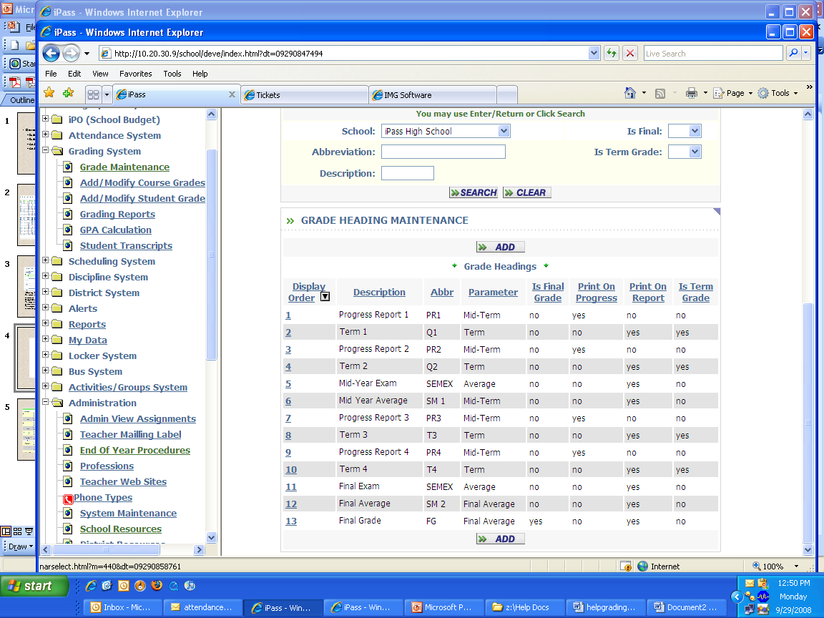
Define Grade Headings
Go To: <Grading System> <Maintenance> <Grade Headings>
This table is not academic year specific.
Care should be taken when changing headings. It will change the headings assigned in the previous years.

Slide 6
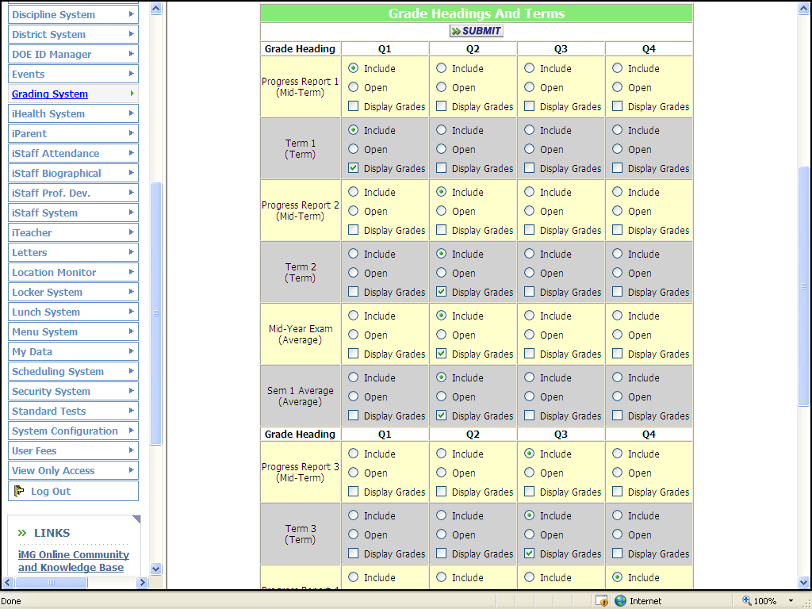
Grade Headings & Terms
Go To: <Grading System> <Maintenance> <Grade Headings & Terms>
This table is academic year and term specific. Care should be taken when assigning Grade Headings, opening and closing them and defining the Grade Parameters.

Slide 7
Grade Headings & Terms
Go To: <Grading System> <Maintenance> <Grade Headings & Terms>
This table is academic year and term specific. Care should be taken when assigning Grade Headings, opening and closing them and defining the Grade Parameters.

Slide 8
Grade Headings & Terms
Go To: <Grading System> <Maintenance> <Grade Headings & Terms>
This table is academic year and term specific. Care should be taken when assigning Grade Headings, opening and closing them and defining the Grade Parameters.

Slide 9
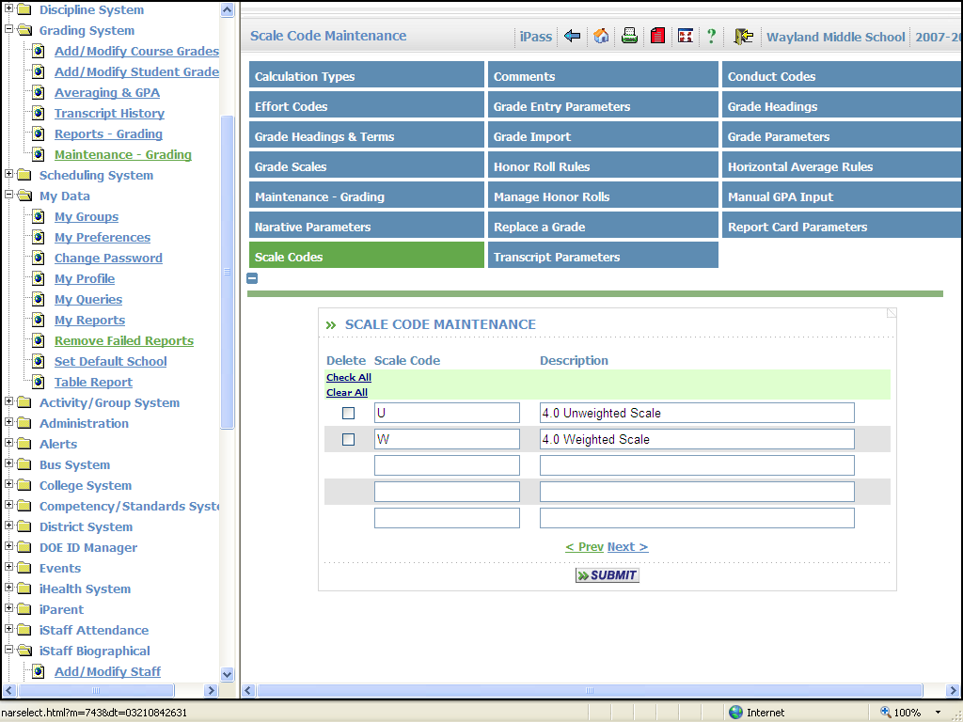
Define GPA Scale Codes
Go To: <Grading System> <Maintenance> <Scales Codes>
This table is not academic year specific. Care should be taken when changing headings. It will change the headings assigned in the previous years. Additional Scale Codes can be added. Existing Scales Codes that were used to calculate GPA should never be removed, in case you need to go back and re-calculate a GPA for a previous year.

Slide 10
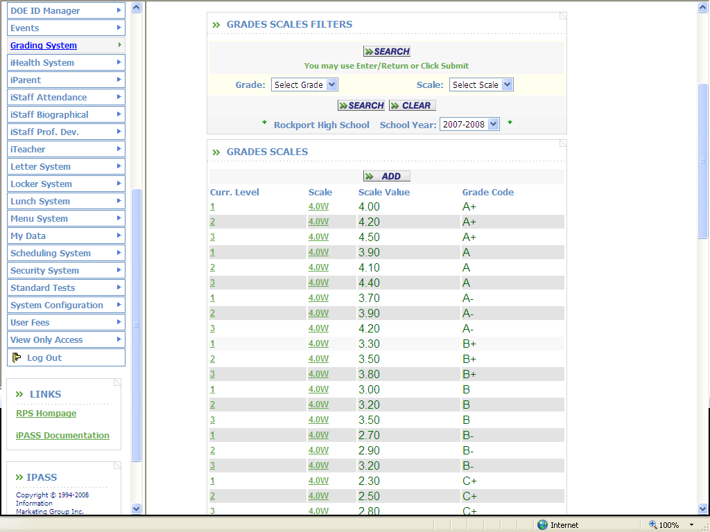
Define Grade Scales
Go To: <Grading System> <Maintenance> <Grade Scales>
Define the values that will be used for GPA calculations for each grade, Curriculum Level and Scale.

Slide 11
Information Marketing Group, Inc.
Thanks for being our customer!

