Slide 1


Information Marketing Group, Inc.
Online Course Recommendations

Slide 2
Online Course Recommendations
  Recommendations Configuration
  Teacher Recommendations
  Parent Recommendations
  Student Recommendations
  Counselor Recommendations
  Turning Recommendations into Requests

Slide 3
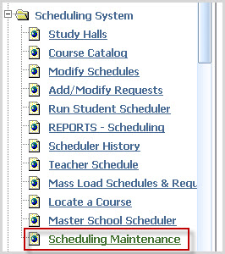
Recommendations Configuration
Prior to opening Online Course Recommendations, the Recommendations Configuration screen must be set.
Open Scheduling System/ Scheduling Maintenance:

Slide 4
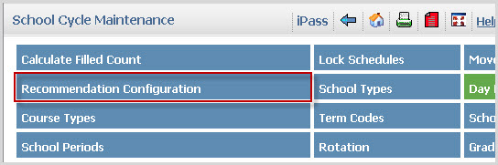
Recommendations Configuration
Click on the Recommendation Configuration tab.

Slide 5
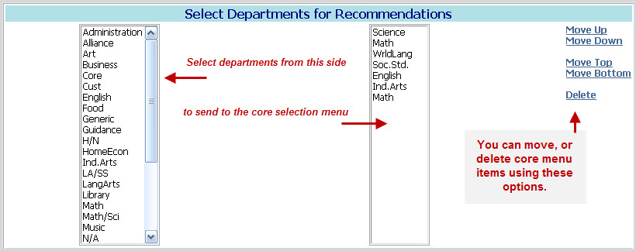
Recommendations Configuration
Select core departments by clicking the department name on the left. Core items will appear on the right side. Organize menu choices by using the Move tools. Delete items using Delete.

Slide 6
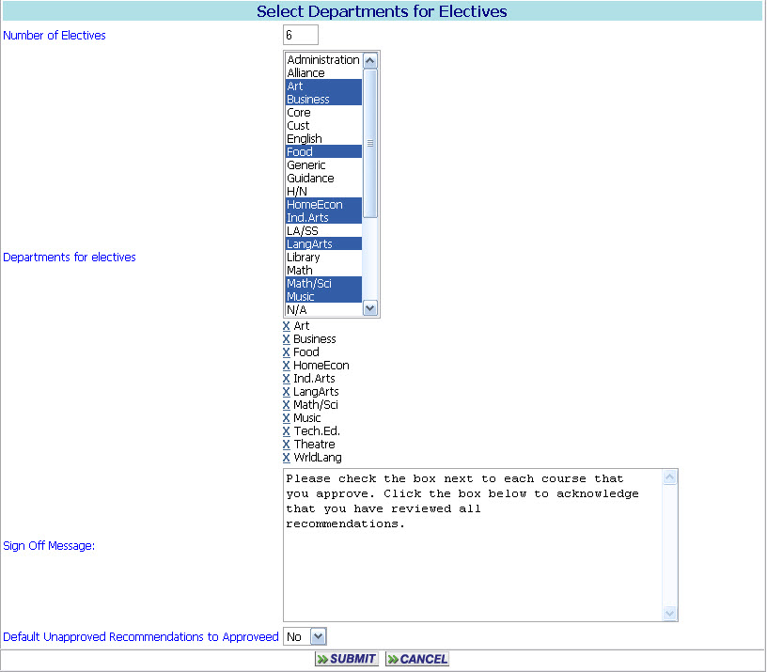
Recommendations Configuration
Set the Number of Electives available.
Select Departments for Electives by Highlighting the Departments for electives. The departments will appear below.

Slide 7
Recommendations Configuration
Compose the Sign Off Message.
The Sign Off Message will appear to users as:

Slide 8
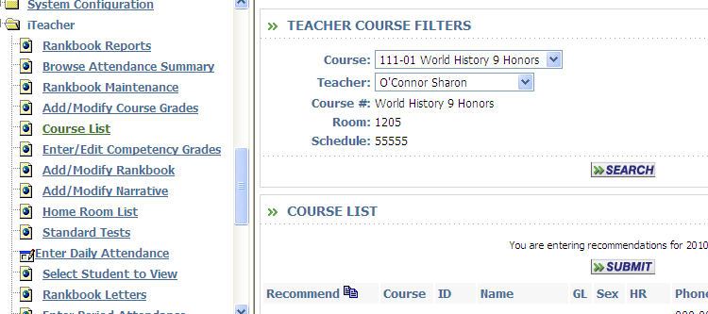
Teacher Recommendations
The Online Course Recommendations process is initiated by teachers.
Teachers will access current course lists.
Select the course list.

Slide 9
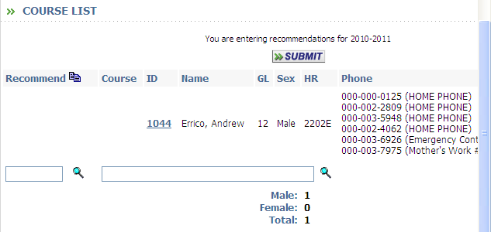
Teacher Recommendations
Teachers may enter the number of recommendations for each student previously set in the recommendations configuration screen
Teachers can either type in a comment or search the comments from the grading system.
Teachers can use the course look-up tool to search the course catalog. If they know the number of the course, they may just type it in.

Slide 10
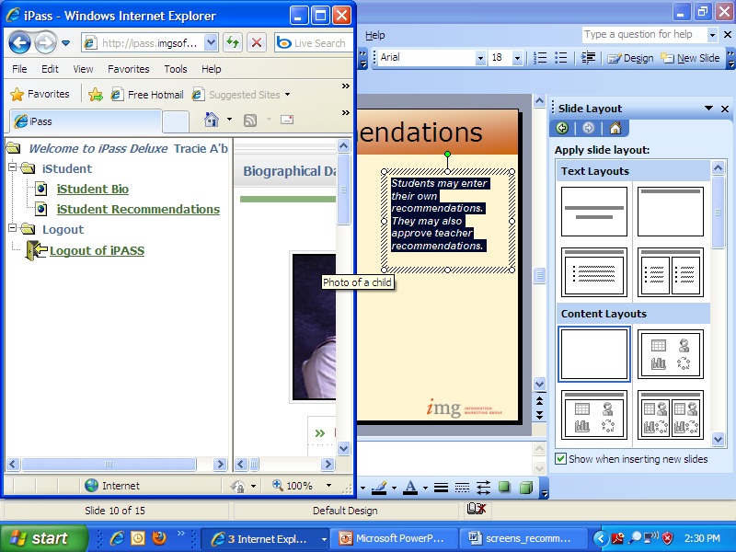
Student Recommendations
Students may have accounts created in iPass
Students are limited to iStudent and Logout folders
iStudent contains “View Only” Biographical and Recommendations

Slide 11
Student Recommendations
Students may enter their own selections for courses for next year.

Slide 12
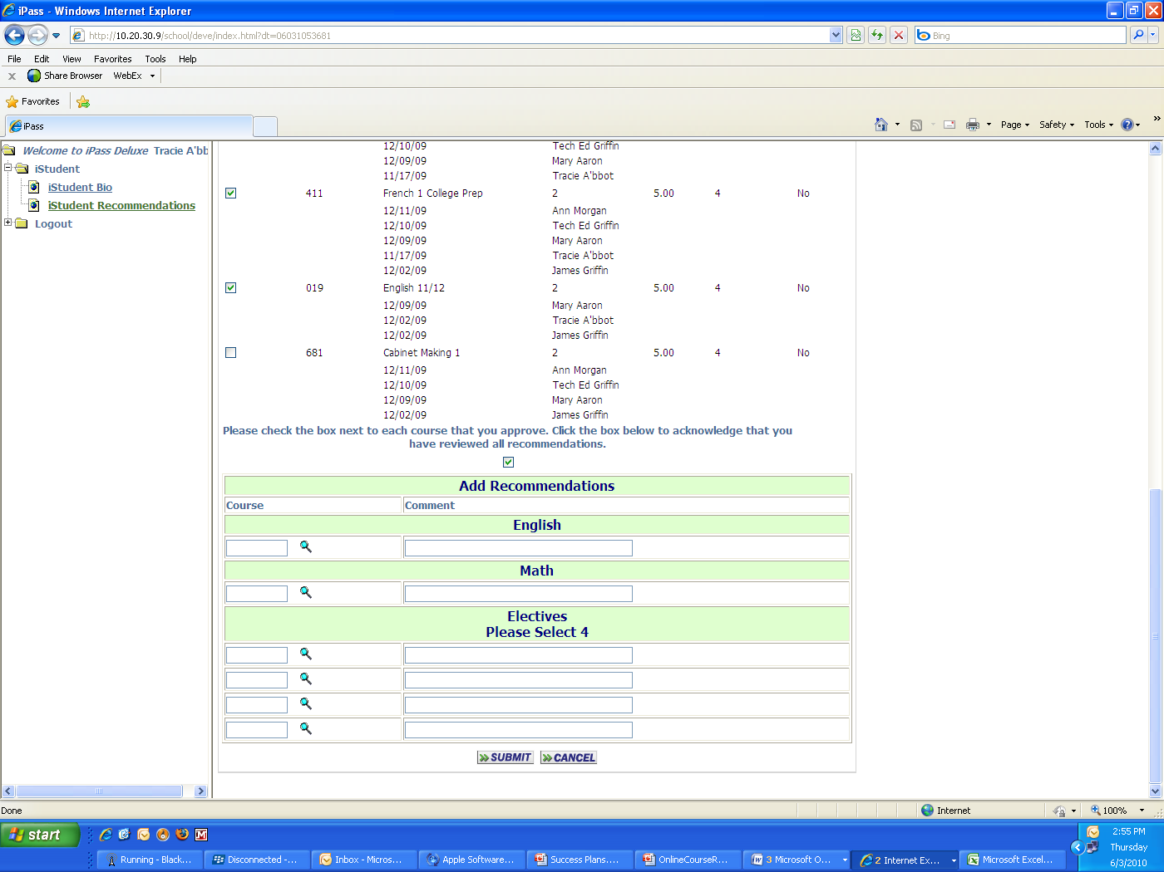
Student Electives
Students may enter the number of electives set on the configurations screen.
It is also limited to the departments selected in configurations.

Slide 13
Parent Recommendations
Parents will log in using iParent and approve the courses recommended for their child.

Slide 14
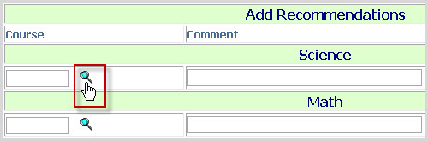
Parent Recommendations
Parents may choose not to approve of teacher recommendations and enter their own recommendations.
Parents will use the look-up tool to search your course catalog and select a course.

Slide 15
Parent Recommendations
Course descriptions and prerequisites are essential in your online course catalog for viewing by parents.

Slide 16
Parent Recommendations
Parents may enter electives for their child.
They may also enter comments regarding their selections.

Slide 17
Parent Recommendations
Parents must check the box acknowledging that they have reviewed all recommendations made by both the student and his/her teachers. These recommendations will then be reviewed by counselors for final approval and scheduling.

Slide 18
Counselor Recommendations
Counselors may wish to enter their own recommendations for a student

Slide 19
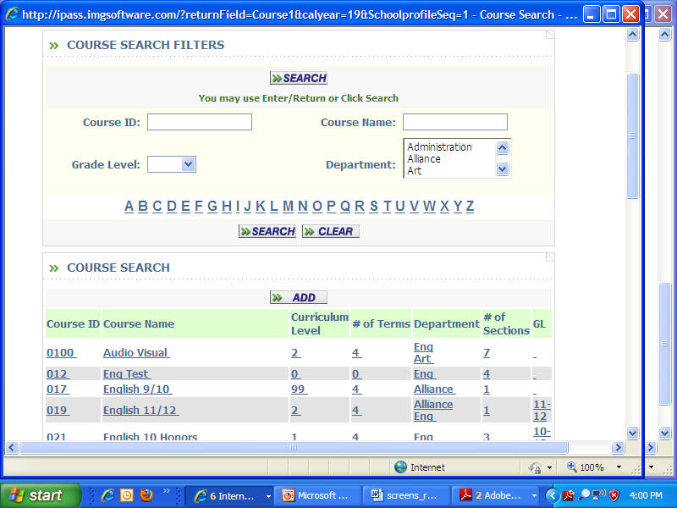
Counselor Recommendations
Courses may be filtered by department.
\

Slide 20
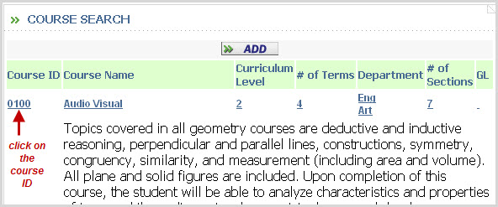
Counselor Recommendations
Select the course recommendation by clicking on the course ID number.

Slide 21
Counselor Recommendations
Add a comment, if desired, and click SUBMIT to save your recommendation.
The new Recommendation will appear with the counselor name.

Slide 22
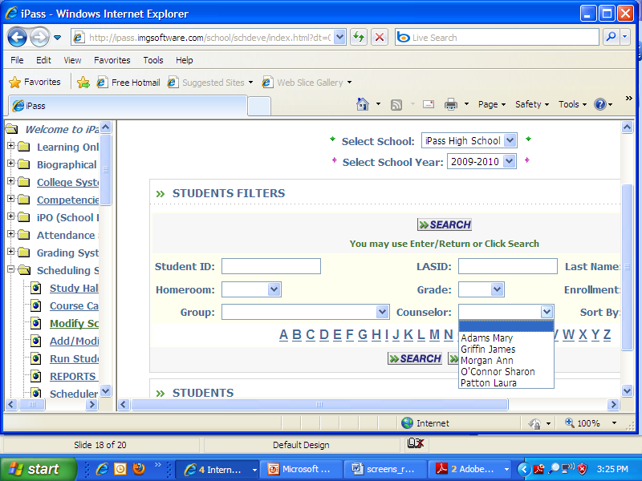
Creating Requests
Counselors start in the Scheduling System.
New feature allows counselors to sort by students assigned to them.

Slide 23
Creating Requests
Start with the first student on the list
Counselors start in the Scheduling System.
Click on the Recommendations tab

Slide 24
Creating Requests
  Counselors will review and evaluate recommendations entered by teachers, parents and students.

Slide 25
Creating Requests
  Counselors will approve the courses that will become actual requests.

Slide 26
Creating Requests
Once all student recommendations are converted to requests the scheduling process can begin!
  Course Request tallies can be run
  Courses Removed that will not be Offered
  Sections Modified
  Teacher and Room Assignments
  Scheduling Students

Slide 27
Information Marketing Group, Inc.
Thanks for being our customer!

